Slide 1
FANTASY FOOTBALL DRAFTABILITY MODEL
Jonah Lessuk, Aneesh Harwalkar, David Doan, Dillan Hong

Slide 2
TABLE OF CONTENTS
01
02
03
Introduction
Dataset
Methodology
04
05
06
Results
Conclusion
Demo

Slide 3
01
Introduction
HOME
00:00
VISITOR
00
00
DOWN
TO GO
BALL ON
QTR
00
00
00
00

Slide 4
Objective
Create a machine learning model that leverages NFL football player statistics from 2017-2023 to predict players’ fantasy rankings given their stats. Our model is designed to help fantasy football managers make smart decisions when selecting players for their rosters.
Notes:
Create a machine learning model that analyzes fantasy football data from 2017-2023 to generate a rating for each player, indicating their draft worthiness for fantasy managers

Slide 5
02
Dataset
HOME
00:00
VISITOR
00
00
DOWN
TO GO
BALL ON
QTR
00
00
00
00

Slide 6
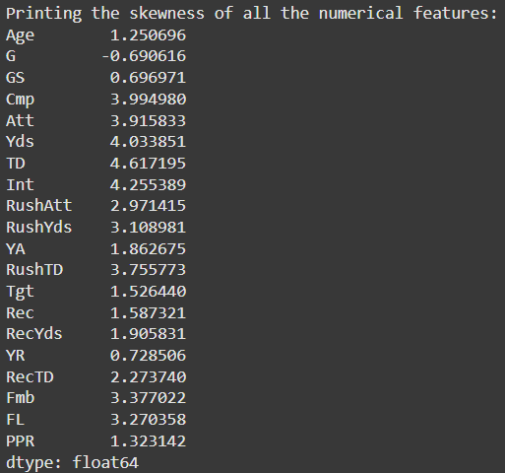
Our Dataset and Data Processing
We found our dataset on Kaggle:
Football statistics by player from 2017-2023
27 columns (features), 3,388 rows
Pre-processing:
Drop columns containing player names, ids, and team
Establish column PosRk (Position Rank) as our label
Non-numerical column “FantPos”
Transform to list and onehotencoder for four unique positions (WR, RB, TE, QB)
Scaling:
PowerTransformer/StandardScaler used to scale skewed numerical columns
Notes:
Describe your Data: Explain the dataset you used, where it came from, and how you pre-processed it. Include information about any data cleaning, transformation, or feature engineering you did.
Dataset:
Origin: Kaggle
Dimensions: 27 columns (features), 3,388 rows
Features: Drop Rk and PosRk. We are predicting rank, so of course we do not want these columns to be included as features. Drop “PlayerID”, “Player”, "Tm" because these features are not relevant to our model.
Label: Position Rank (PosRk)
Most columns are numerical, with the exception of the position columns, or FantPos. We transformed the four unique position columns into lists and then onehotencoded these lists.
PowerTransformer and StandardScaler (in that order) used to scale the numerical columns that were skewed. (All columns of interest were skewed).

Slide 7
03
Methodology
HOME
00:00
VISITOR
00
00
DOWN
TO GO
BALL ON
QTR
00
00
00
00
Notes:
7-12 David

Slide 8
Our models: Linear Regression, Support Vector Regression, Decision Trees, Random Forest, and Gradient Boosting
Step-by-step:
Feature selection and pre-processing
Feature correlation analysis
Train/test split
Train multiple models
Evaluate Models
Save the best model
Test the final model
Evaluate using MSE, MAE, and R-squared values
Save the best model using Pickle
One test with randomized inputs is included in the original code. Since our model is saved and can be exported, we can test it more thoroughly in our demo program.
Notes:
Methodology:
Initial feature selection: see previous slide
Drop non-predictive columns
Use PosRk as target label
Feature correlation analysis
Calculate correlation matrix for numerical features
Use heatmap to visualize correlations
Preprocessing: see previous slide
Scale/standardize using standardscaler/powertransformer
Encode categorical data using onehotencoder
Train-test split
Split data into training and testing sets
Model training
Train multiple models so they can be evaluated/compared
Different models use different types of modeling to analyze data. This ensures that we find a model that is not negatively affected by the characteristics/shape/properties of the data.
Linear regression, ridge, lasso
Svr
Decision tree, random forest
Gradient boosting regressor
Model evaluation
Mean squared error and mean absolute error
R-squared score
Save model using pickle
Visualizations
Test final model
Trained model predicts rankings using the testing dataset
These rankings are compared to actual rankings to determine their accuracy

Slide 9
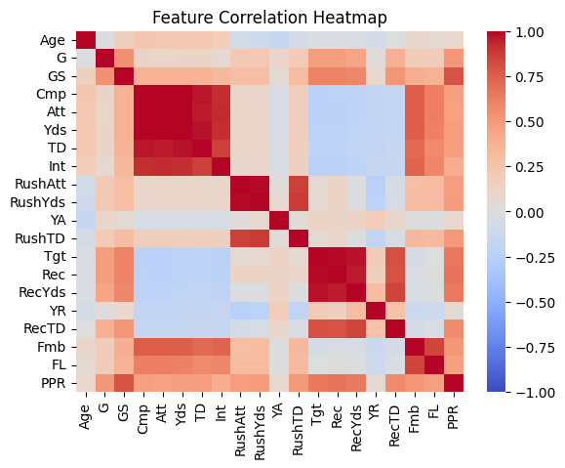
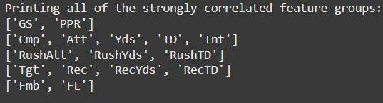
We scaled our data this way because…
Many of these features are positively correlated, creating problems like:
Redundant information
Complicates model interpretability
Can lead to overfitting
How can we fix this?

Slide 10
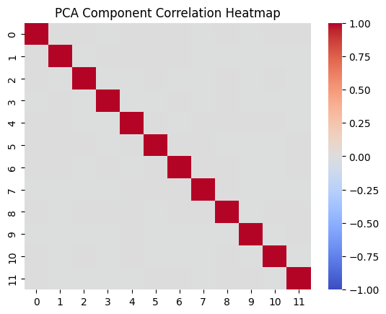
Principal Component Analysis
What does PCA do?
Reduces dimensionality
Removes multicollinearity
BUT…
PCA only works on normalized data:
applied Power Transform to skewed data
Standard Scaling to normalize data

Slide 11
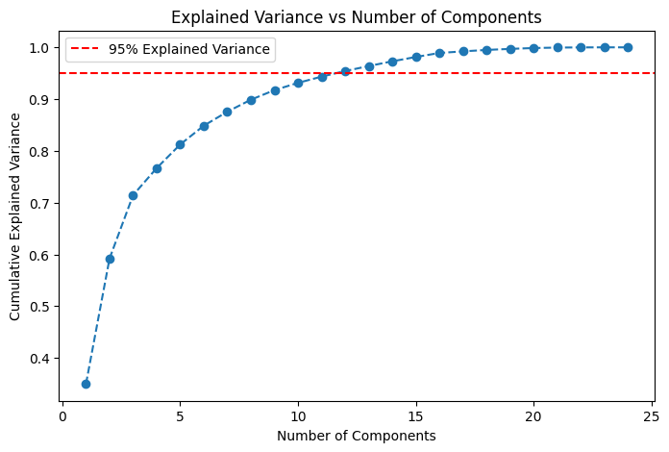
Principal Component Analysis

Slide 12
Training all the models
Many of our models require the data to be PCA transformed, while others can handle multicollinearity and lose defining information when PCA transformed.
Cannot handle multicollinearity:
Linear Regression
SVR with Linear Kernel
SVR with Polynomial Kernel
SVR with RBF Kernel
Can handle multicollinearity:
Linear Ridge Regression
Linear Lasso Regression
Decision Tree
Random Forest
Gradient Boosting

Slide 13
04
Results
HOME
00:00
VISITOR
00
00
DOWN
TO GO
BALL ON
QTR
00
00
00
00
Notes:
Dillan

Slide 14
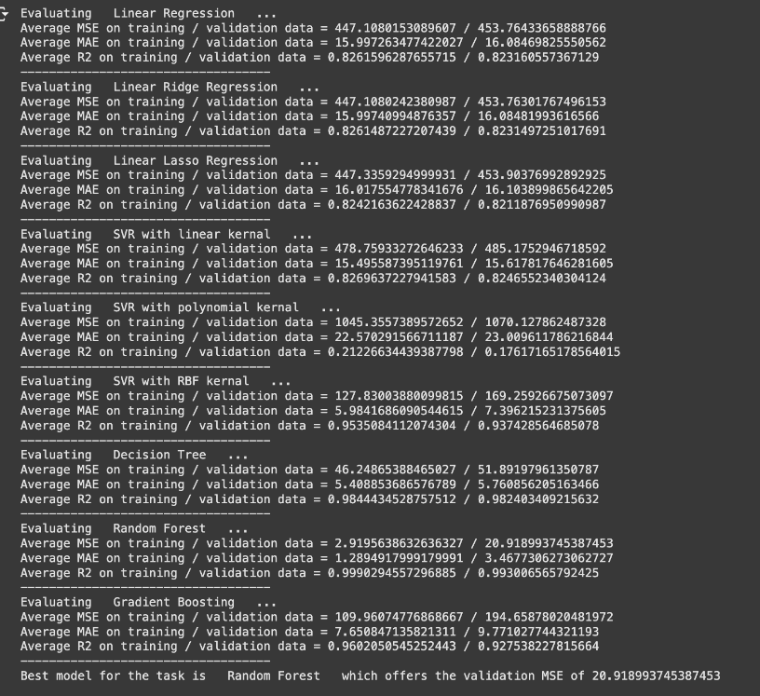
Model Evaluation Metrics (Training and Validation)
Random Forest model achieves lowest MSE (20.91).
High R^2 confirms strong predictive accuracy.
Outperformed Decision Tree and Gradient Boosting models.
Notes:
Dillan - We compared several models, including Decision Trees, Gradient Boosting, and Random Forests, using metrics like Mean Squared Error (MSE), Mean Absolute Error (MAE), and R^2. The Random Forest model performed the best with an MSE of 20.91, which indicates its predictions are highly accurate. The model's high R^2 further demonstrates its ability to explain the variance in player draftability.

Slide 15
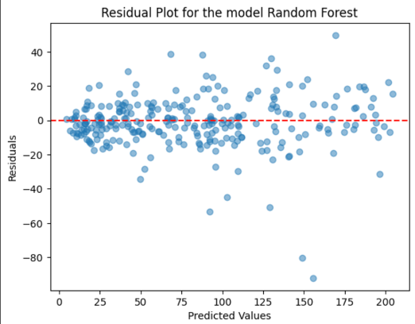
Residual Plot (Random Forest Model)
Visualizes prediction errors (residuals) vs. actual values.
Random scatter shows minimal bias.
Confirms the model generalizes well across player ratings.
Notes:
Dillan - The residual plot helps us evaluate how well the model predicts draftability. Random scatter around the zero line indicates minimal bias, suggesting the model doesn’t consistently over- or under-predict. This result confirms that our Random Forest model performs reliably across different player values, making it a trustworthy tool for draft predictions.

Slide 16
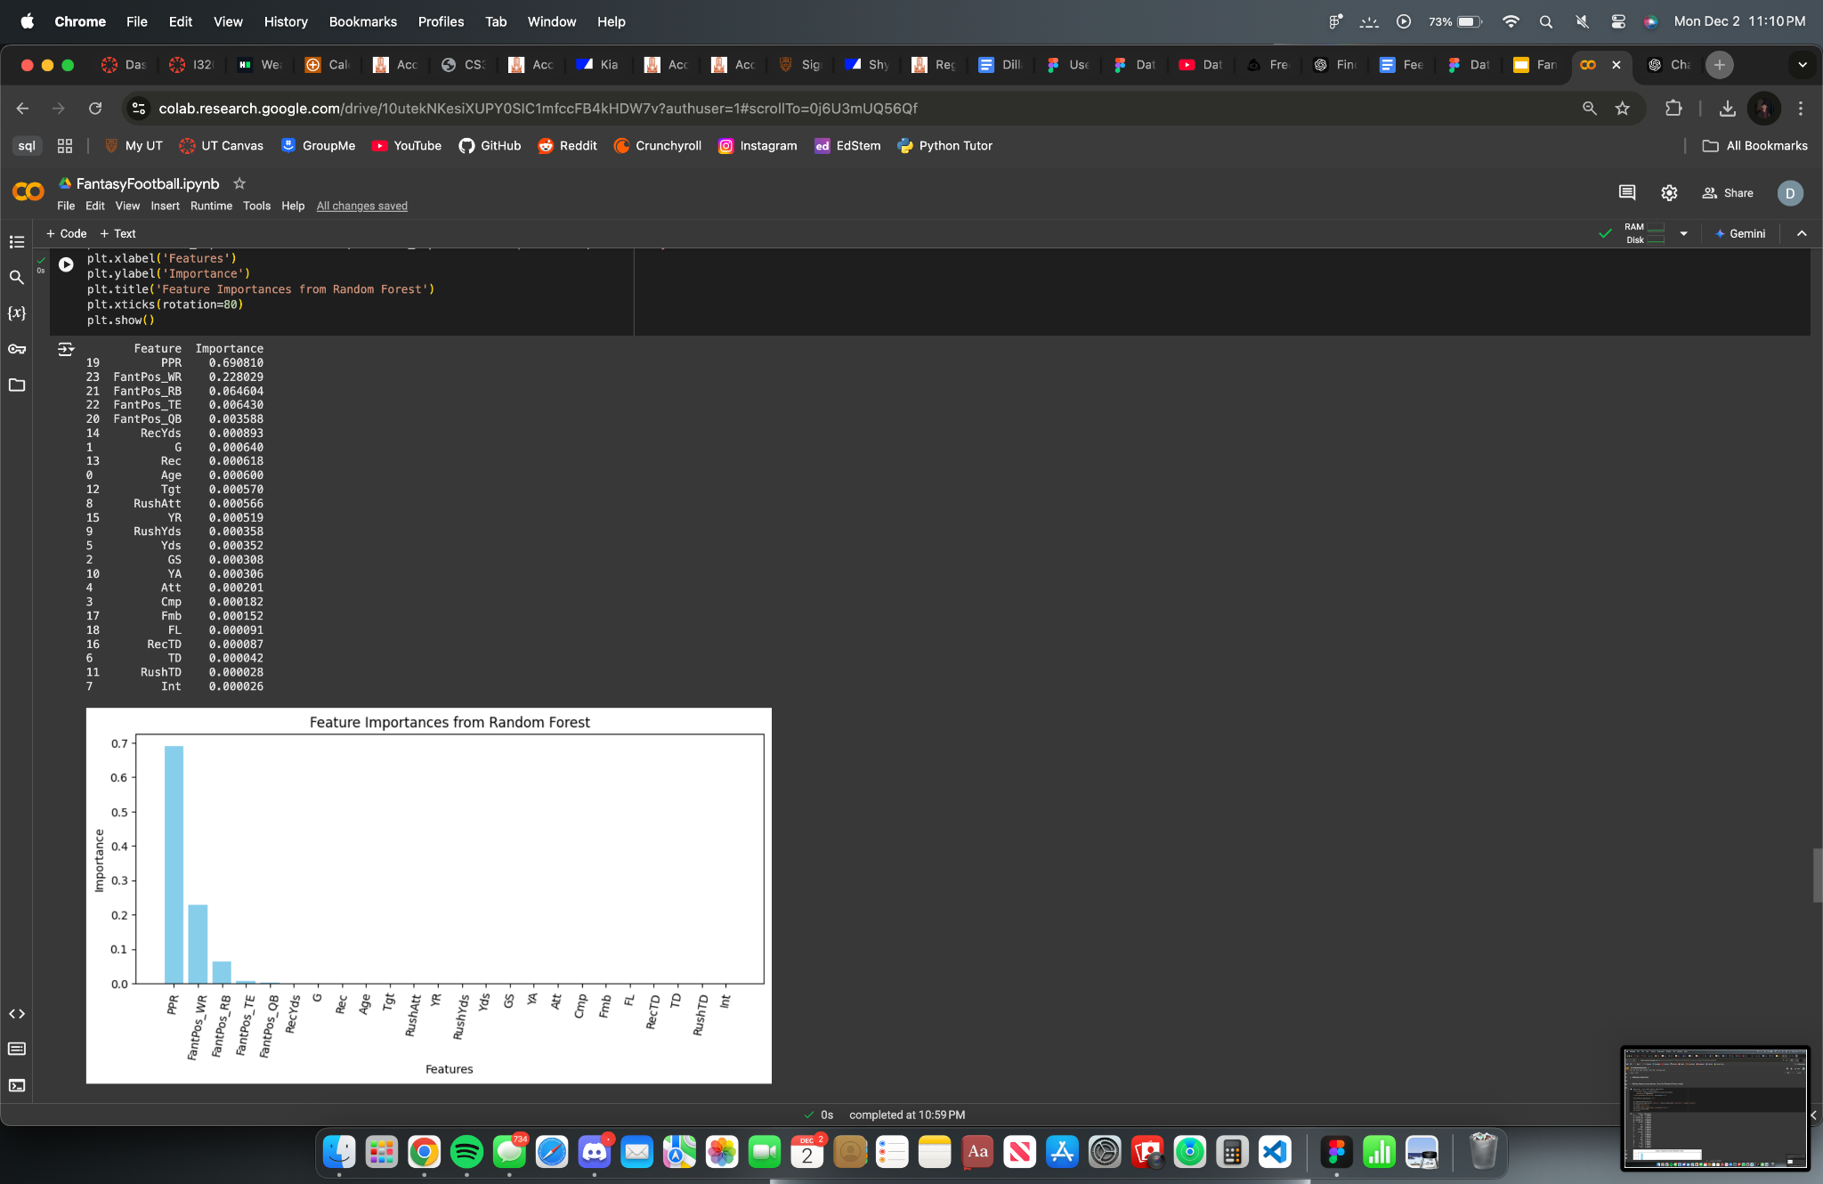
Feature Importance Bar Chart (Random Forest Model)
Highlights top factors for predicting draftability (e.g., PPR, FantPos_WR).
Most impactful features likely to align with real-world fantasy strategies.
Positional data heavily influences draft decisions.
Notes:
Dillan - The feature importance bar chart shows that "PPR" (Points Per Reception) is the most influential factor, followed by position-related metrics like "FantPos_WR" (Wide Receiver) and "FantPos_RB" (Running Back). This reflects real-world fantasy football strategies where positions and scoring formats heavily impact player value. These findings validate that the model aligns with how managers evaluate draftability. By knowing what drives predictions, managers can better assess players in their drafts.

Slide 17
Detailed Feature Importances Table
(Random Forest Model)
Numerical ranking of feature importance (e.g., PPR: 0.6, FantPos_WR: 0.2).
Adds transparency to the model's decision-making process.
Reinforces the reliability of feature importance results.
Notes:
17-20 Jonah
This table complements the feature importance bar chart by providing precise numerical rankings of each features’ contribution. For example, "PPR" has a weight of 0.6, significantly higher than other features. This transparency ensures stakeholders trust the model's decisions and gives managers actionable insights for draft preparation.

Slide 18
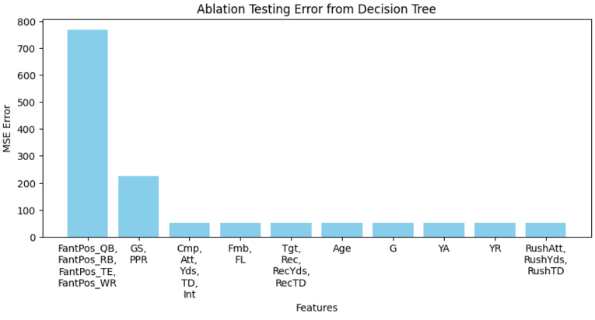
Ablation Testing Bar Chart (Decision Tree Model)
Tests impact of removing features on prediction accuracy.
Removing FantPos_-, PPR, and GS categories causes the largest error increase.
Notes:
Here we performed ablation testing to measure how much error increases when a single feature is removed. For example, removing "FantPos_" (Overall Position) or “GS” (Games Started) and/or “PPR” (Points per reception) drastically worsens the model’s performance, proving their critical role in accurate predictions. This analysis ensures we’re focusing on the features that truly matter, refining our model to provide better insights into draftability.

Slide 19
05
Conclusion
HOME
00:00
VISITOR
00
00
DOWN
TO GO
BALL ON
QTR
00
00
00
00

Slide 20
Conclusions
Findings:
PPR and positional metrics are key to draftability.
Random Forest is the most accurate model.
Limitations:
Temporal changes in player trends not captured.
Lack of real-time data reduces immediate applicability.
Future Applications:
Real-time draft tools.
Extend to other fantasy sports.
Notes:
In summary, we found that PPR and positional metrics like "FantPos_WR" are the most critical factors for predicting draftability. Predictions may rely mainly on these values, and altering the different features might barely change the results in the demo.The Random Forest model, with the lowest MSE and strong R^2, emerged as the best-performing model. However, the model has limitations, such as not accounting for temporal trends or live data, which could improve predictions.

Slide 21
06
Demo
HOME
00:00
VISITOR
00
00
DOWN
TO GO
BALL ON
QTR
00
00
00
00

Slide 22
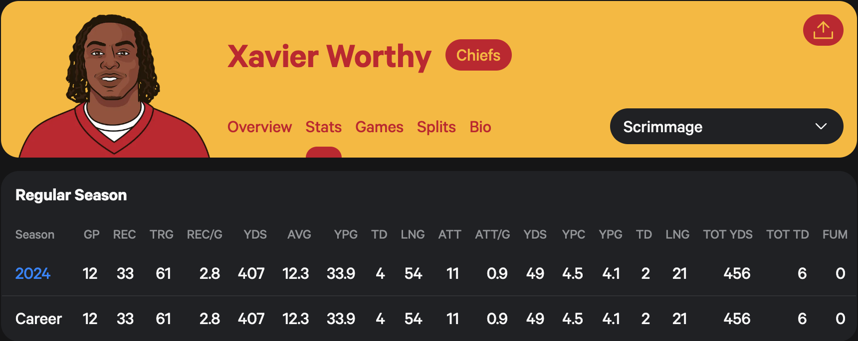

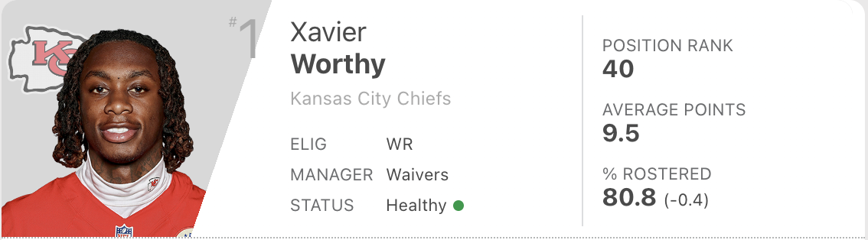
https://www.statmuse.com/nfl/player/xavier-worthy-31096/career-stats
https://fantasy.espn.com/football/players/add
Notes:
Methodology:

Slide 23
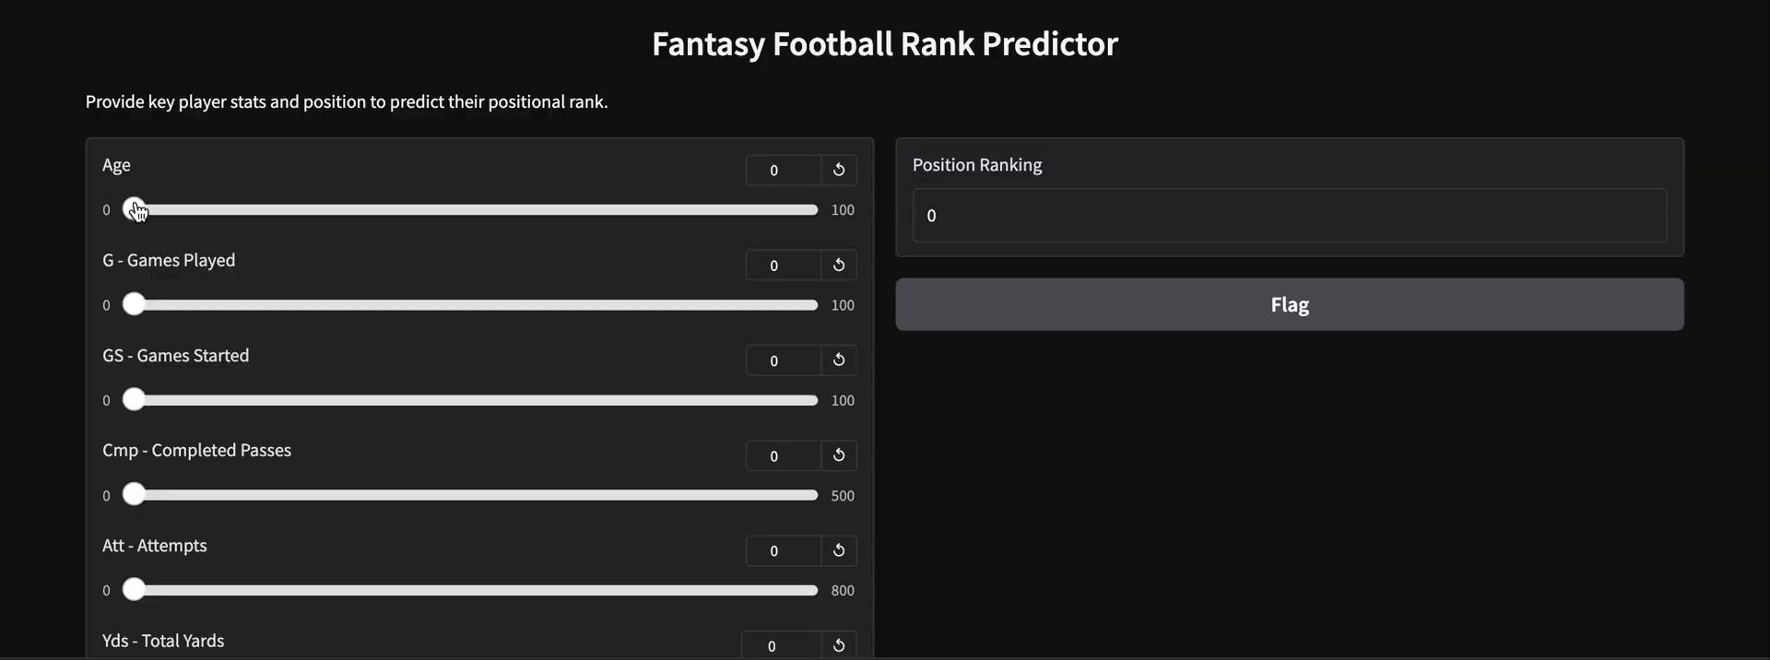
Notes:
Methodology:

Slide 24
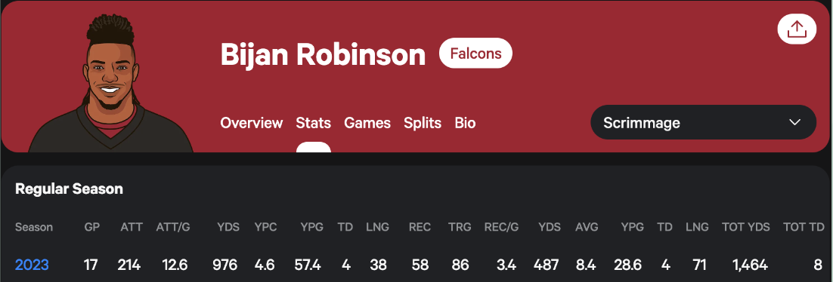

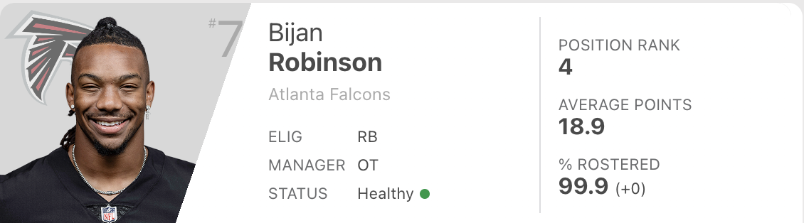
https://www.statmuse.com/nfl/ask/bijan-2023-ppr
https://fantasy.espn.com/football/players/add
Notes:
Methodology:

Slide 25

Notes:
Methodology:

Slide 26
Thanks for listening!

Slide 27
Q & A
What was the rationale behind selecting Position Ranking as the target value for prediction, rather than Overall Ranking?
We chose to select Position Ranking for our label instead of the Overall Ranking because in fantasy football, scoring differs depending on the specific position of the player, whether it’s QB, RB, WR, TE. Some positions will get more points than others for the same statistic so we decided that delivering the user a position rank might be more beneficial and accurate.
What factors led to the decision to use regression models for prediction rather than other machine learning algorithms?
We used regression analysis because it provides more detailed and precise predictions among players. Given our skewed data, where many stats are clustered on the lower end, regression allows us to rank players with similar stats more effectively.
Could you provide a detailed description of the mechanics behind Power Transformation in data preprocessing?
See the following slide…

Slide 28
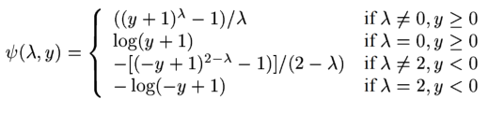
Power Transformation
At its basic description, Power Transformation changes skewed data to fit a normal distribution (Gaussian). And there are two methods:
Box-Cox: Applicable only to datasets with positive values (excluding 0)
Yeo-Johnson: Applicable to datasets with positive and negative values
For our project, we used Yeo-Johnson transformation as certain stats aren’t applied to all player positions. For instance, quarterbacks don’t have stats in receptions.
How does Yeo-Johnson transformation work technically?
For all the positive values, the Yeo-Johnson
transformation applies a formula similar to Box-Cox, where
y is the original data value and λ is a parameter that determines the specific equation to be applied. This λ parameter is chosen to maximize the likelihood of achieving a Gaussian distribution, generally iterating through possible values until the highest likelihood is achieved.

Slide 29
References
Link to the Kaggle dataset:
“Fantasy Football Data 2017 - 2023” by Gary Bolduc https://www.kaggle.com/datasets/gbolduc/fantasy-football-data-2017-2023?select=fantasy_merged_7_17.csv
References:
Yeo, In‐Kwon, and Richard A. Johnson. “A new family of power transformations to improve normality or symmetry.” Biometrika, vol. 87, no. 4, 1 Dec. 2000, pp. 954–959, https://doi.org/10.1093/biomet/87.4.954.

